Slide 1
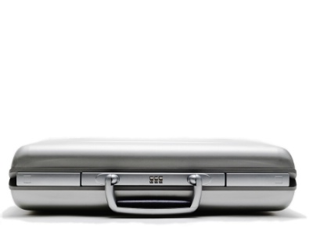
Progress on ‘universal life’ and ‘index-linked’ contracts, presentation and disclosures – moving closer to re-exposure IFRS 4 Phase II Update
IASB and FASB joint meetings – November 2012
Francesco Nagari
Deloitte Global IFRS Insurance Lead Partner
5 December 2012

Slide 2
Agenda
Highlights of decisions from this month joint and IASB-only meetings
Detailed analysis of the Staff recommendations and Boards discussions
Update on timetable and next steps

Slide 3
Highlights
Joint IASB/FASB decisions – 20 November
Acceptance that certain non-par contracts have cash flows affected by assets (e.g. universal life and index-linked)
Introduced new application guidance to allow the reset through income of the asset returns’ effect on those cash flows with the difference through OCI
IASB only decisions – 21 November
Presentation requirements for balance sheet and income statement have been refined
Disclosure requirements for the mirroring approach and balance sheet movement reconciliation
Disclosure requirement on transition simplified
Approach to fieldwork after re-exposure agreed
IFRS 9 ED on the OCI model has been issued on 28 November – comments due on 28 March 2013

Slide 4
Discount rate for contracts for which mirroring approach does not apply – paper 2A/95A
Staff Recommendation
The Staff recommended that for contracts whose cash flows are not subject to the
mirroring approach but have cash flows that are affected by asset returns:
The discount rate that reflects the characteristics of the contract’s cash flows shall reflect the extent to which the estimated cash flows are affected by the return from those assets. This would be the case regardless of whether the:
transfer of the expected returns of those assets are the result of the exercise of insurer’s discretion (e.g. universal life insurance contracts); or
the specified assets are not held by the insurer (e.g. index-linked insurance contracts)

Slide 5
Discount rate for contract for which mirroring approach does not apply – paper 2A/95A (cont.)
Discussion
Brief discussion
All generally agreed with Staff proposals.
Both the IASB and FASB supported the staff recommendations
Decision | IASB vote | FASB vote
Approve Staff recommendation | Majority (12 vs. 2) | Unanimous
Notes:
The IASB staff presented paper 2A and its recommendation to use an earned premium presentation, “whereby premiums are allocated to periods in proportion to the value of coverage that the insurer has provided in the period, and claims are presented when incurred”.
On the other hand, the FASB staff proposes to use a premium due presentation, “whereby premiums are presented when due and an expense representing the claims, benefits and margins associated with these premiums is presented at the same time”.
The IASB started the discussion and it quickly became clear that the majority was in favour of the Staff recommendation. Although some Board members acknowledged the complexity of the approach, they believe it is a step towards consistency with other industries, as well as being a good indicator of performance. Some Board members expressed a preference for the summarised margin approach and suggested to use that if no consensus was reached on the earned premium presentation.
For reasons similar to the IASB’s, the FASB agreed that a premium earned presentation would be preferable to the “premium due”, which is what the FASB Staff was proposing. The FASB finds the premium earned to be more consistent with “revenue recognition” and a better proxy for volume. A few Board members also expressed a preference for the summarised margin approach however, understands that it does not address the need for volume information that the industry wish to see.
Both Boards voted in favour of using the premium earned presentation (IASB: 13 in favour, FASB: 5 in favour). The Chairman of the FASB asked that the method for determining the revenue not to be prescriptive.

Slide 6
Discount rate for contract for which mirroring approach does not apply – paper 2A/95A (cont.)
Staff recommendation – Discount rate where the cash flows are affected by expected asset returns
Upon any change in expectations of the crediting rate used to measure the insurance contracts liability, an insurer shall reset the locked-in discount rate that is used to present the interest expense
Discussion
Brief discussion
All generally agreed with Staff proposals
Decision | IASB vote | FASB vote
Approve Staff recommendation | Majority (all of 14 present IASB members) | Unanimous

Slide 7
Presentation of insurance contracts in the balance sheet – paper 3B – IASB only
Staff recommended that in the statement of financial position an insurer should
present all rights and obligations arising from an insurance contract on a net basis
be required to present separate line items for insurance contracts and for reinsurance contracts.
The Staff also recommended to amend the list of minimum specified line items in paragraph 54 of IAS 1 to add insurance contracts and reinsurance contracts.
After some deliberation, the Board agreed to raise the issue in another meeting with no tentative decisions taken at this point on this matter
Decision | IASB Vote
Approve Staff recommendation | Unanimous

Slide 8
Presentation of insurance contracts in the income statement – paper 3B – IASB only
Staff Recommendation
The general requirements of IAS 1 are sufficient to satisfy the presentation requirements for the statement of comprehensive income for insurance contracts
Discussion
Brief discussion. IAS 1 has been deemed sufficient to guide insurers on the choice of line items and disclosures about all material items that would be relevant to understand the insurer’s financial performance.
Decision | IASB Vote
Approve Staff recommendation | Unanimous

Slide 9
Disclosures on Contracts under the “Mirroring Approach”– paper 3C – IASB only
Staff recommendation – participating contracts
an insurer should disclose the carrying amounts of insurance contract liabilities arising from contracts to which the mirroring approach has been applied, and
if an insurer measures the underlying items in a participating contract on a basis other than fair value, and discloses the fair value of the underlying items, the insurer shall disclose the extent to which the difference between the fair value and carrying value of underlying assets would be passed to policyholders.
Example
An insurer chooses the cost model to present in its financial statements investment property backing liabilities that pay a return linked directly to the fair value of, or returns from, specified assets including that investment property. According to the requirements of IAS 40.79e, the insurer should also disclose the fair value of that investment property
Cost
Users would like to know whether this difference is passed to policyholders or shareholders
Fair Value
Notes:
At its September 2012 meeting, the IASB tentatively approved a proposed disclosure package, noting that it would consider at a future date any additional disclosures that might be appropriate in light of later decisions. The IASB has subsequently reached decisions on three matters for which additional disclosures might be appropriate: participating contracts, measurement of premiums and claims in the statement of comprehensive income, and transition.
Participating contracts
In the light of these decisions, the Staff considered whether there would be a need for disclosures about participating contracts in addition to the disclosures that the IASB agreed at the September 2012 meeting. Concerns were raised that measuring the insurance contract liability on the same basis as underlying assets may result in reduced comparability between the liabilities of different insurers. This is because the measurement basis of the underlying assets may differ between insurers and, furthermore, there may be more than one permitted option for measuring the underlying item, e.g. investment property, which could be carried at either amortized cost or fair value. To alleviate this concern, the Staff proposed that, when an insurer applies the mirroring approach, the insurer should disclose the carrying amounts in the financial statements that arise from cash flows that vary with the underlying items.
Discussion
The Staff noted that measuring the insurance contract liability on the same basis as underlying assets may result in reduced comparability between the liabilities of different insurers. This is because the measurement basis of the underlying assets may differ between insurers and, furthermore, there may be more than one permitted option for measuring the underlying item, e.g. investment property, where the insurer can choose between the fair value model or the cost model.
In the cases where the underlying item is not carried at fair value in the insurer’s financial statements which could be the case for financial assets carried at amortised cost or investment properties carried at depreciated cost, the Staff think that it would be useful to inform users of financial statements that the policyholders have an economic interest in the difference between the fair value of the underlying assets and their carrying amount. Without such disclosure, users of financial statements may have incomplete information because part of the fair value that is disclosed will be passed through to policyholders, and will not go to the insurer’s shareholders.

Slide 10
Disclosures on Contracts under the “Mirroring Approach”– paper 3C – IASB only (cont.)
After the explanations provided on the purpose and use of the additional disclosures proposed, the Staff asked the Board to vote on its recommendations
Decision | IASB Vote
Approve Staff recommendation | Unanimous
Notes:
After these clarifications, the Staff asked the Board to vote on its recommendations for participating contracts:
a) an insurer should disclose the carrying amounts of insurance contract liabilities arising from contracts to which the mirroring approach has been applied, and
b) if an insurer measures the underlying items in a participating contract on a basis other than fair value, and discloses the fair value of the underlying items, the insurer shall disclose the extent to which the difference between the fair value and carrying value of underlying assets would be passed to policyholders.
The Board agreed unanimously with the Staff’s recommendations.

Slide 11
Earned Premiums and reconciliation of balances – paper 3C – IASB only
Staff Recommendation
How to modify the disclosure requirements relating to reconciliation of contract balances?
Are any additional disclosures needed?
Insurers already disclose a reconciliation from the opening to the closing balance of the aggregate carrying amount of insurance contracts
Using the earned premium presentation means that the amounts presented in the income statement for contracts accounted for using the BBA and those accounted for using the PAA would be the same
The same reconciliation requirements would be useful to explain the amounts for contracts that apply either the BBA or the PAA.

Slide 12
Earned Premiums and reconciliation of balances – paper 3C – IASB only (cont.)
Discussion
Some Board members shared their concerns that the proposed disclosure requirements might become very cumbersome and detailed.
Other Board members questioned the applicability and feasibility of the proposed disclosure requirements to different jurisdictions.
The Staff responded that
disclosures proposed under the 2010 ED had been welcomed by various interest groups and
the main change in the new proposals was to have the same requirements for contracts accounted for under the BBA and PAA
Many Board members noted the Staff proposals would add to the quality of information provided in the financial statements and to the comparability between insurance entities
Decision | IASB Vote
Approve Staff recommendation | Unanimous

Slide 13
Inputs to the measure of insurance contract revenue – paper 3C
Staff recommendation
An insurer should disaggregate in a note to the financial statements the insurance contract revenue into the inputs considered for the determination of this revenue in the period, i.e.
the probability-weighted claims, benefits and expenses expected to be incurred in the period;
the allocation of expected acquisition costs
the risk adjustment changes relating to that period’s coverage, and
the residual margin allocated to that period.
The Staff acknowledged that such disaggregation would only be feasible for contacts accounted for under the BBA because this information would not be obtainable for contracts accounted for under the PAA.

Slide 14
Inputs to the measure of insurance contract revenue – paper 3C (cont.)
Discussion
One Board member expressed his strong disagreement with this proposal because it was too detailed. Another Board member agreed with this view and suggested that these disclosures may be excessive and thus of no benefit to users.
The majority of the Board members however insisted that revenue is the most critical figure users are looking for and so supported the Staff proposal.
Decision | IASB vote
Approve Staff recommendation | Majority (13 vs. 2)

Slide 15
Disclosure of premiums written and due – paper 3C – IASB only
Staff recommendation
For contracts accounted for using the BBA, insurers should disclose the effect of contracts written in the period on the insurance liability, showing separately the effect on:
the expected present value of future cash outflows, showing separately the amount of acquisition costs;
the expected present value of future cash inflows;
the risk adjustment; and
the residual margin.
Decision | IASB Vote
Approve Staff recommendation | Unanimous

Slide 16
Disclosure of premiums written and due – paper 3C – IASB only (cont.)
Staff Recommendation
On premiums due the Staff recommended that the IASB does not require additional disclosures about premiums receipts or a reconciliation from earned premium to premiums due or received
This information is already provided by the requirement to disclose the amount of premiums received as part of the reconciliation movements in the period
IASB Comments
Some Board members disagreed with the Staff’s recommendations and argued that premiums due should be clearly disclosed in the financial statements
This a measure of the volume of activity which is highly recognised by investors
They also added that under the new proposals the premium due is to disappear from the information presented in an insurer’s financial statements
The IASB rejected the Staff recommendation and tentatively decided that an insurer should disclose a reconciliation from premium receipts to revenue
Decision | IASB Vote
Approve Staff recommendation | 6 vs. 9

Slide 17
Simplification of transition disclosures – paper 3C – IASB only
Staff recommendation
When an insurer first applies the new insurance contracts standard, paragraph 28(f) of IAS 8 would require disclosure of the line item amounts that would have been reported in accordance with the previous accounting policy per the current IFRS 4 (the Phase I standard):
for the current period, and
for prior periods that are required to be restated.
Staff recommended that when the IFRS 4 revised (the Phase II standard) is initially adopted this requirement is not applied
Decision | IASB Vote
Approve Staff recommendation | Unanimous

Slide 18
Fieldwork post re-exposure – paper 3E – IASB only
The objectives for the fieldwork would be to:
(a) understand how the targeted proposals in the five areas of significant change from the 2010 ED proposals would be applied in practice;
(b) evaluate the costs and benefits of the targeted proposals; and
assess how the proposed approach will help insurers to communicate with users of their financial statements.
Fieldwork participants would be asked to apply the proposed measurement model to a selected portfolio(s) of insurance contracts over two annual periods
Depending on the type of insurance contracts selected, the participants would then provide the results to the applicable questions
Prior fieldwork volunteers would be invited to participate in the third round of fieldwork that will be initiated after IASB’s re-exposure draft
Fieldwork questionnaires and other materials would be ready at the time of re-exposure with users’ workshops fieldwork activity during the comment letter period
A preliminary analysis of the results will be presented at the same time as the comment letter analysis

Slide 19
Next steps and timetable
Next joint meeting expected in the week commencing 17 December
IASB will commence its fieldwork preparation
IFRS 9 exposure draft on the OCI solution for financial asset is now out for comments with a 120 days comment period
The decisions of the IASB confirm Deloitte’s expectations of a Mandatory effective date of the new IFRS of 2017
The risk for a slippage of the completion timetable makes 2018 as the second most likely scenario for adoption

Slide 20
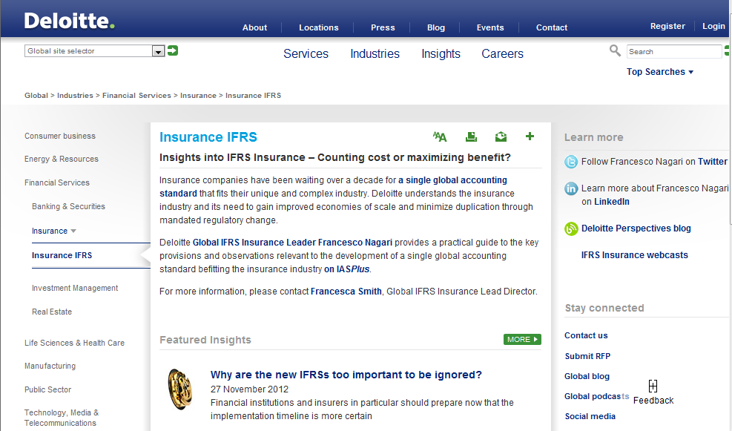
Contact details
Francesco Nagari
Deloitte Global IFRS Insurance Lead Partner
+44 20 7303 8375
fnagari@deloitte.co.uk
@Nagarif
Deloitte Insights into IFRS Insurance (i2ii)
www.deloitte.com/i2ii
Insurance Centre of Excellence:
insurancecentreofexc@deloitte.co.uk

Slide 21
This seminar and the accompanying hand-outs cover topics only in general terms and are intended to give a wide audience an outline understanding of issues relating to accounting applicable to entities in the insurance sector, and therefore cannot be relied on to cover specific situations; applications of the principles set out will depend on the particular circumstances involved. Furthermore, responses given in the seminar to questions are based on only an outline understanding of the facts and circumstances of the cases and therefore do not form an appropriate substitute for considered specific advice tailored to your circumstances. We recommend that you obtain professional advice before acting or refraining from acting on any of its contents. We would be pleased to advise you on the application of the principles demonstrated at the seminar and other matters to your specific circumstances but in the absence of such specific advice cannot be responsible or liable.
Deloitte LLP is a limited liability partnership registered in England and Wales with registered number OC303675 and its registered office at 2 New Street Square, London EC4A 3BZ, United Kingdom. Deloitte LLP is the United Kingdom member firm of Deloitte Touche Tohmatsu ('DTT'), a Swiss Verein, whose member firms are legally separate and independent entities. Please see www.deloitte.co.uk\about for a detailed description of the legal structure of DTT and its member firms.
© 2012 Deloitte LLP. Private and confidential
Notes:
20

